Slide 4
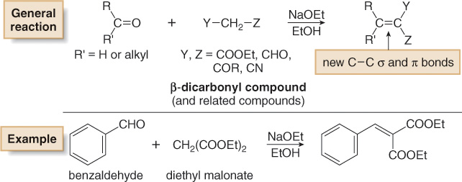
Carbonyl Condensation Reactions
Crossed Aldol Reactions
[2] When one carbonyl component has especially acidic α hydrogens, these hydrogens are more readily removed than the other α H atoms. As a result, the β-dicarbonyl compound always becomes the enolate component of the aldol reaction.

Slide 5
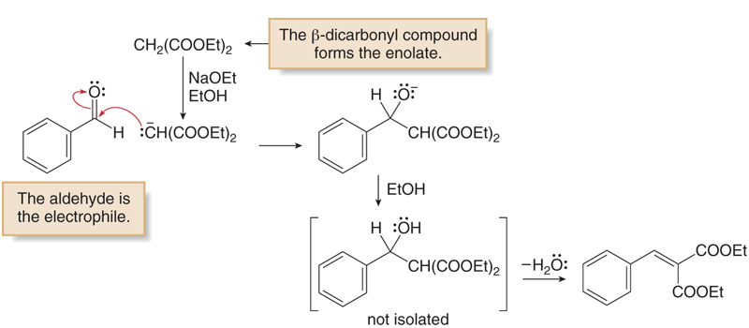
Carbonyl Condensation Reactions
Crossed Aldol Reactions
Figure 24.2 below shows the steps for the crossed aldol reaction between diethylmalonate and benzaldehyde. In this type of crossed aldol reaction, the initial β-hydroxy compound always loses water to form the highly conjugated product.
Figure 24.2
Crossed aldol reaction
between benzaldehyde and
CH₂(COOEt)₂

